Slide 1
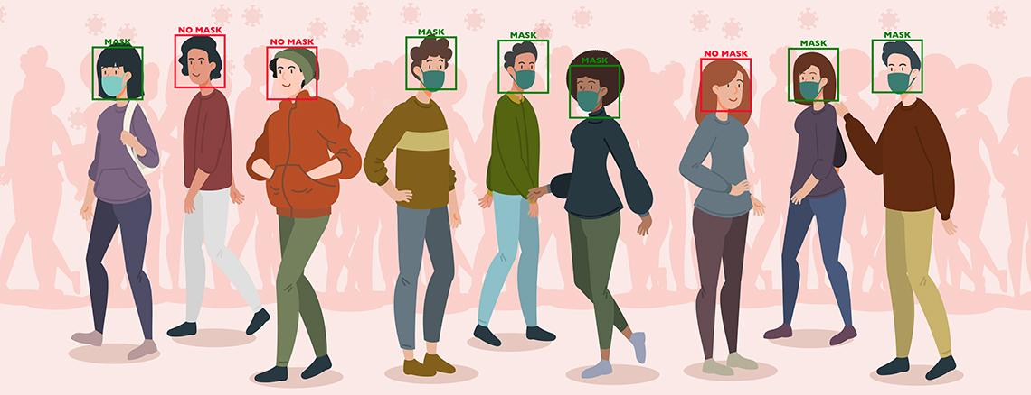
Face Mask Detection With In-built E-Challan System Using AI

Slide 2

TECH AVENGERS
Vipul
Tamboli
Saurabh
Sisodiya
Sanyam
Sharma
Lavi
Vashishth
Team Leader
B.Tech. II year
Computer Science
vipultamboli2000@gmail.com
Team Member
B.Tech. II year
Computer Science
ssisodiya.2001@gmail.com
Team Member
B.Tech. II year
Computer Science
sanyamsharma2602@gmail.com
Team Member
B.Tech. II year
Computer Science
lavi1182001@gmail.com

Slide 3
Objective
The main objective of the project is to use a model based approach for the facial recognition of the driver in real time environment.
Here, we aim to develop a model to facilitate the drivers and the traffic police to manage the penalties for the covid violation i.e. to impose an E challan digitally on the drivers who drive without wearing masks .

Slide 4
Why We choose
A finer approach of charging the E challan.
Contribution towards awareness for health.
Contribution towards Digital India.

Slide 5

ROADMAP
Detection of mask
Detect Number plates.
1
1
3
2
4
Capturing vehicle image.
Fetch the number,
create E-challan.

Slide 6
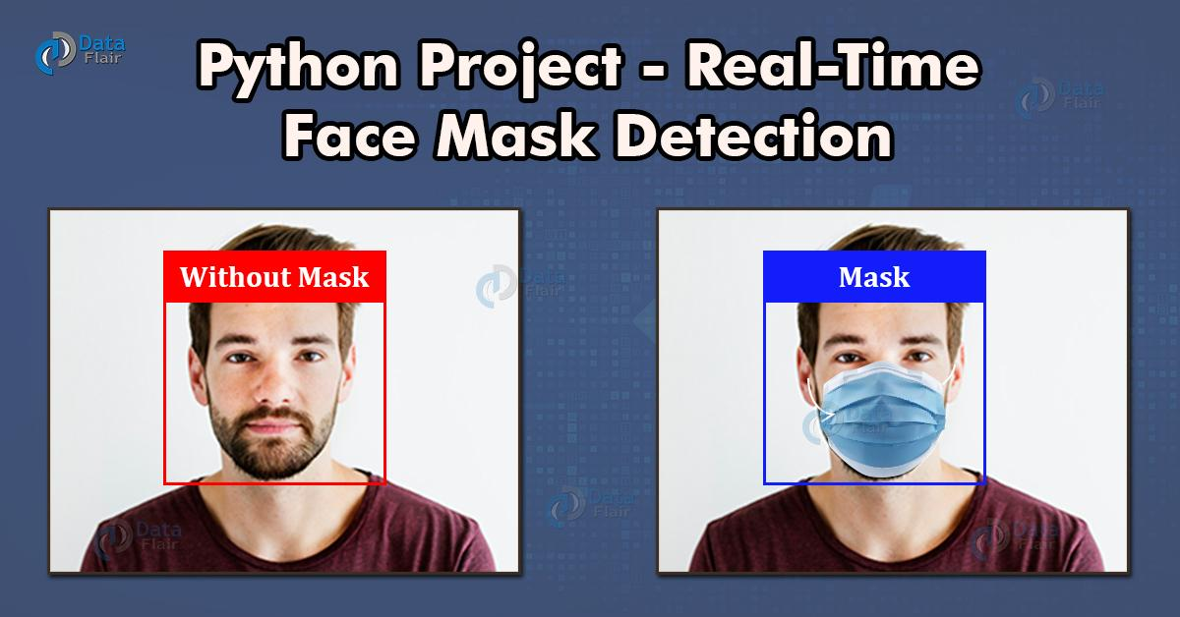
Detection of mask
Here we’ll focus on loading our face mask detection dataset followed by training the model on this dataset, and thus serializing the face mask detector.
Once the face mask detector is trained, we can then move on to loading the mask detector, performing face detection, and then classifying each face as with mask or without mask.

Slide 7
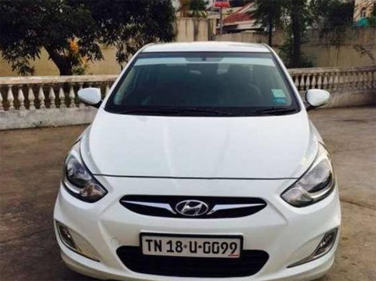
Capturing vehicle image
If our system detects any rider with no mask than a screenshot of his vehicle will be taken for further actions.

Slide 8
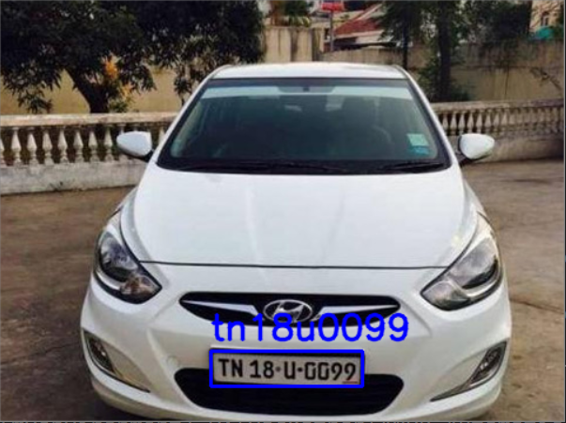
Fetching Vehicle Number
Here, we will fetch vehicle number from the vehicle image that has been captured and will fine the concerned person accordingly.

Slide 9
Technology To Be Used
TensorFlow
Keras
OpenCV
Imutils
Pandas
NumPy

Slide 10
Benefits
No corruption.
Less Human Resources.
Less Human Interaction.
Less Time Consuming.
Less paperWork.

Slide 11
FUTURE IMPLEMENTATION
In future we can further add other government traffic rule detection systems with it.
We can partially replace traffic police with our system.
We can use this kind of systems in other government offices too, to detect any kind of illegal activities.

Slide 12
CONCLUSION
While there are many potential benefits to using the technology to prevent and solve crimes, there are many concerns about the privacy, safety and legislation regarding the use of the technology.

Slide 13
Thank You!

